Slide 1
A potential sol. to Algal bloom
0712238 林彥彤

Slide 2
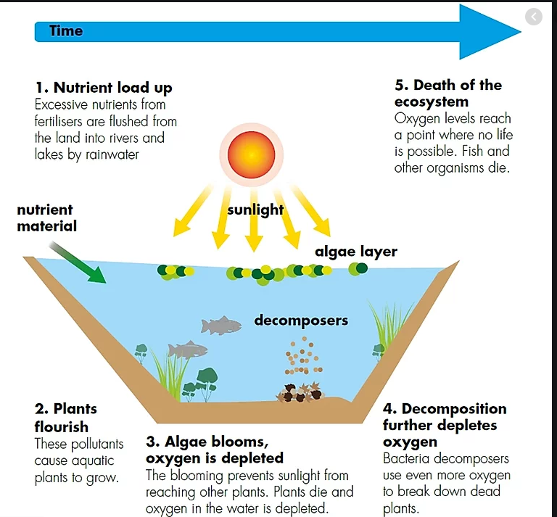
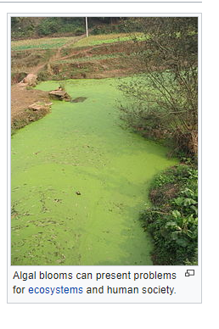
The problem
https://www.ldi.ee/row-algae

Slide 3
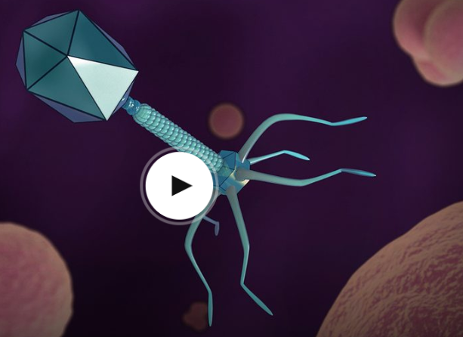
Bacteriophages(phages)
https://www.ted.com/talks/alexander_belcredi_how_a_long_forgotten_virus_could_help_us_solve_the_antibiotics_crisis?language=zh-tw#t-101028

Slide 4
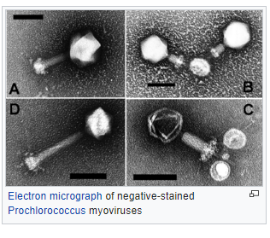
Since Cyanobacteria is bacteria
there is actually Cyanobacteria killer
-Cyanophage

Slide 5
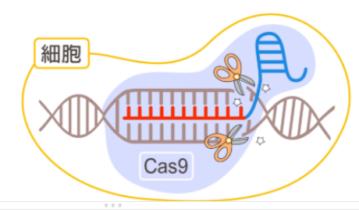
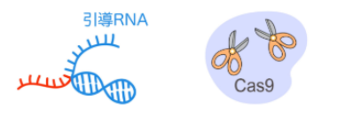
CRISPR/Cas - bacteria immune system
DATA BASE
ACGTACGTA….
CGTACATGG….
…..

Slide 6
Phages+Cripsr-cas9 pair as a filter
Alive
Modified Cyanobacteria
+Cripr/Cas9 for phage
+phages for the species to the environment
Unmodified Cyanobacteria
w/o Cripr/Cas9 for phage
Dead

Slide 7
Want the GM Cyanobacteria
to limit its own growth rate when P-conentration is high.

Slide 8
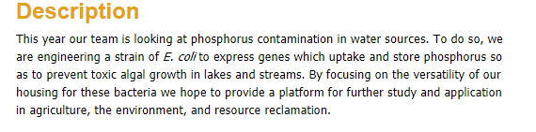
IGEM 2016 Team Purdue used a gene that can make E.coli collect P

Slide 9
instead of GM E.coli to store P
can try to modify Cyanobacteria itself
and make it the dominant Cyanobacteria in the potentially polluted water.

Slide 10
Description
the water contains GMO more than original species
Not prone to overgrow when the water is with excessive amount of P
Phages+
Cripsr-cas9 protected GMO

Slide 11
Biobrick -
Microlunatus phosphovorus
Microlunatus phosphovorus is the type species of the Microlunatus bacterial genus.
It is Gram-positive and is notable for
being a polyphosphate-accumulating bacterium.
It is coccus-shaped, aerobic, chemoorganotrophic and its type strain is NM-1^{T}.

Slide 12
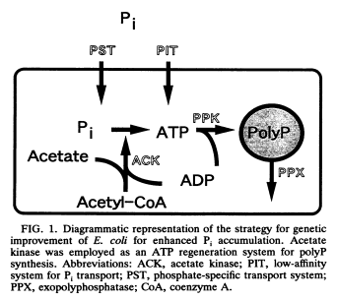
Biobrick - The process of storing P in Ecoli supported by a paper

Slide 13
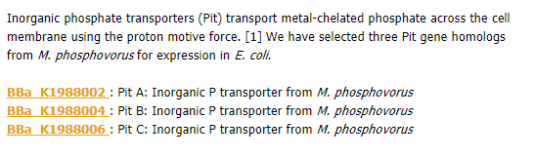
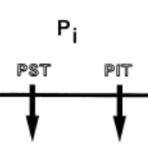
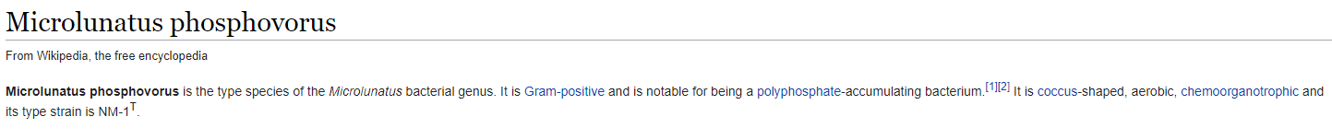
BioBrick Used - for PIT

Slide 14
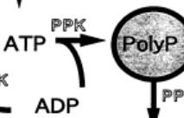

BioBrick Used - for PPK
Polyphosphate-dependent glucokinases (PPGK) catalyze the first step of glycolysis, the phosphorylation of glucose using a phosphate group from polyphosphate or ATP

Slide 15
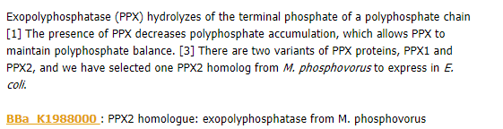
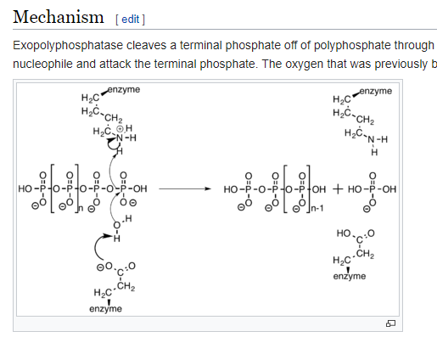
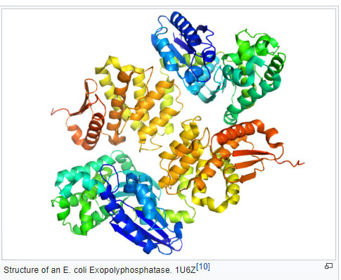
BioBrick Used - for PPX

Slide 16
Experiments to do
Phages+Cripsr-cas9 pair as a filter
is the phage effective enough?
can the original cyanbaceria gain resistance to cyanphage
The growth rate of Gene Modified Cyanobacteria is well limited
try on different P concentration and build a model

Slide 17
Bio safety
need to confirm that the GMO and phages won’t cause harm to the environment
consider adding “target” to phases and let the CRISPR remember target instead of original phases sequence to avoid creating “super” cyanobacteria

Slide 18
Reference
phages TED
https://www.ted.com/talks/alexander_belcredi_how_a_long_forgotten_virus_could_help_us_solve_the_antibiotics_crisis?language=zh-tw#t-662188
細菌的死亡筆記本-CRISPR/Cas技術
https://www.narlabs.org.tw/xcscience/cont?xsmsid=0I148638629329404252&sid=0J030336920470561193
2016 IGEM TEAM PURDUE
http://2016.igem.org/Team:Purdue/Description
Genetic Improvement of Escherichia coli for Enhanced Biological Removal of Phosphate from Wastewater
https://aem.asm.org/content/aem/59/11/3744.full.pdf
A Novel Biocontainment Strategy Makes Bacterial Growth and Survival Dependent on Phosphite
bio growth controlled by P
https://www.nature.com/articles/srep44748
(Microlunatus phosphovorus gene)

Slide 19
Thank you for listening

